Slide 1
The ‘distance’ between two homologous DNA sequences

Slide 2
Homologous DNA sequences
Two copies of a gene, or of part of a genome, are homologous if they are descended from a common ancestral copy that existed some time in the past.
‘homologous’ is usually what we mean when we refer to multiple copies of the ‘same’ gene.

Slide 3
The ‘distance’ between two homologous DNA sequences
If two aligned homologous DNA sequences are not identical, then we may want to put a number to how different they are
This number, or ‘distance’, may mean different things. Some possible meanings of ‘distance’:
Observed number of differences
Estimated number of mutations that have happened since common ancestry
Estimated time since common ancestry

Slide 4
Distance between Sequences
Seq1 TGTCACGTCAGACTGTACGCT
Seq2 TGCCACGTCGGACTGTACGTT
Seq1 Seq2
Differences are caused by mutation since common ancestry
The longer the time since common ancestry, the more mutations and differences, on average
However there could have been more mutations than there are differences:
Some mutations may be reversals
Similar mutations might have happened on each branch of the tree
Common
Ancestor
Time

Slide 5
Distance between Sequences
We can observe how many differences there are between two sequences
If we want to estimate the actual total number of mutations that have occurred since common ancestry then we need to develop a mathematical model
Also, if we want to estimate the time since common ancestry, then we need some idea of what the mutation rate is over time, to convert estimated numbers of mutations to time

Slide 6
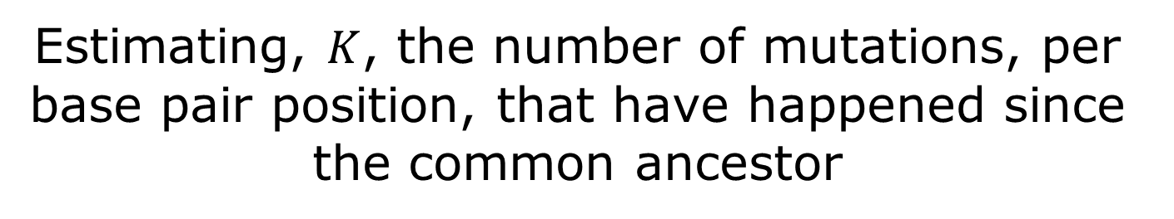
Estimating, $K$, the number of mutations, per base pair position, that have happened since the common ancestor
Consider two homologous, aligned sequences.
Their comparison reveals some sites in which the bases are identical, and some where they are different.
How can we estimate the actual number of mutations that have occurred?
One could just count the number of differences
but this is a minimum number and it may be much lower than the true number of mutations
This is because it is possible that some of the sites where the bases are the same have actually had 2 or more mutations (a change then a change back), and it is possible that some of the sites that are different have had two or more differences.

Slide 7
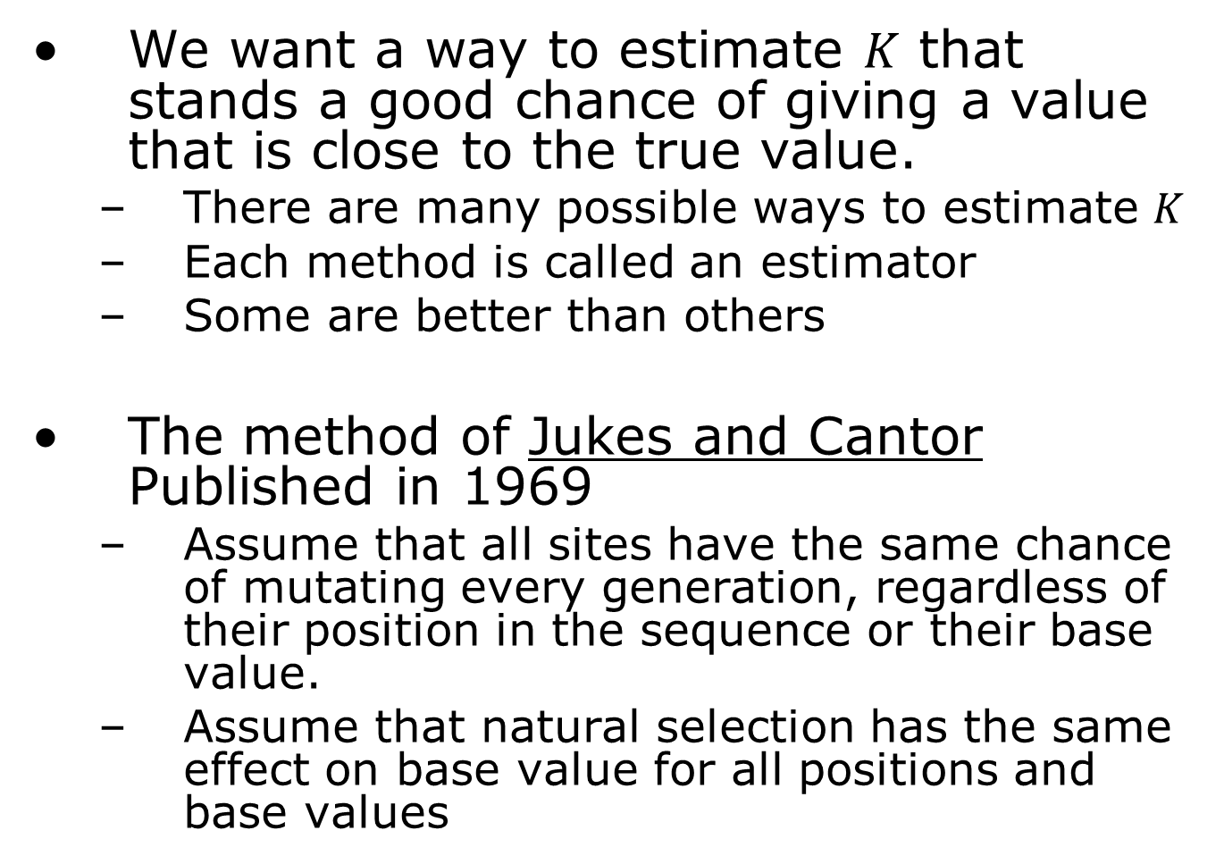

Estimating $K$
We want a way to estimate $K$ that stands a good chance of giving a value that is close to the true value.
There are many possible ways to estimate $K$
Each method is called an estimator
Some are better than others
The method of Jukes and Cantor Published in 1969
Assume that all sites have the same chance of mutating every generation, regardless of their position in the sequence or their base value.
Assume that natural selection has the same effect on base value for all positions and base values

Slide 8
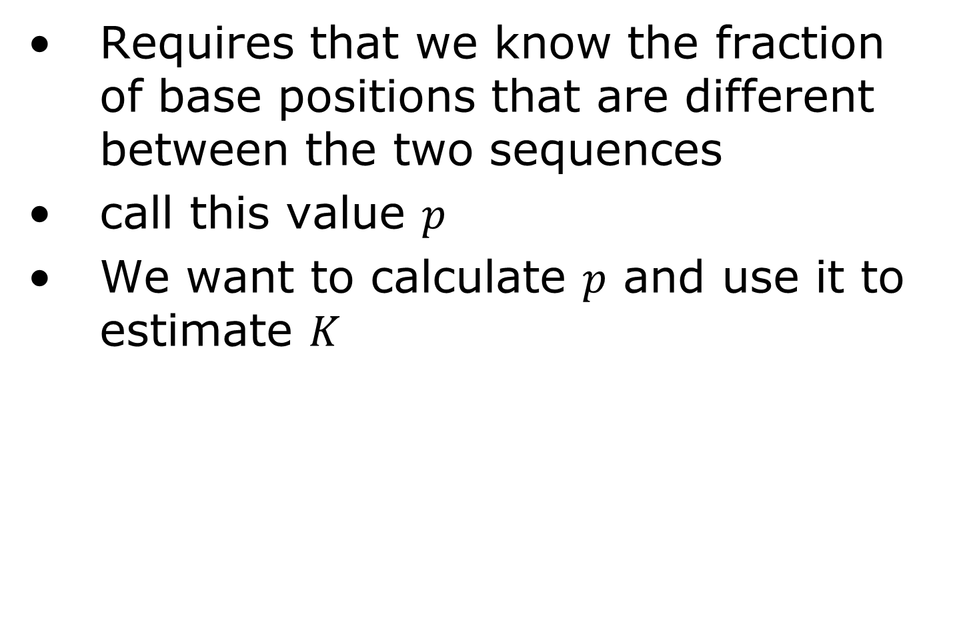

Estimating $K$ using Jukes & Cantor
Requires that we know the fraction of base positions that are different between the two sequences
call this value $p$
We want to calculate $p$ and use it to estimate $K$

Slide 9
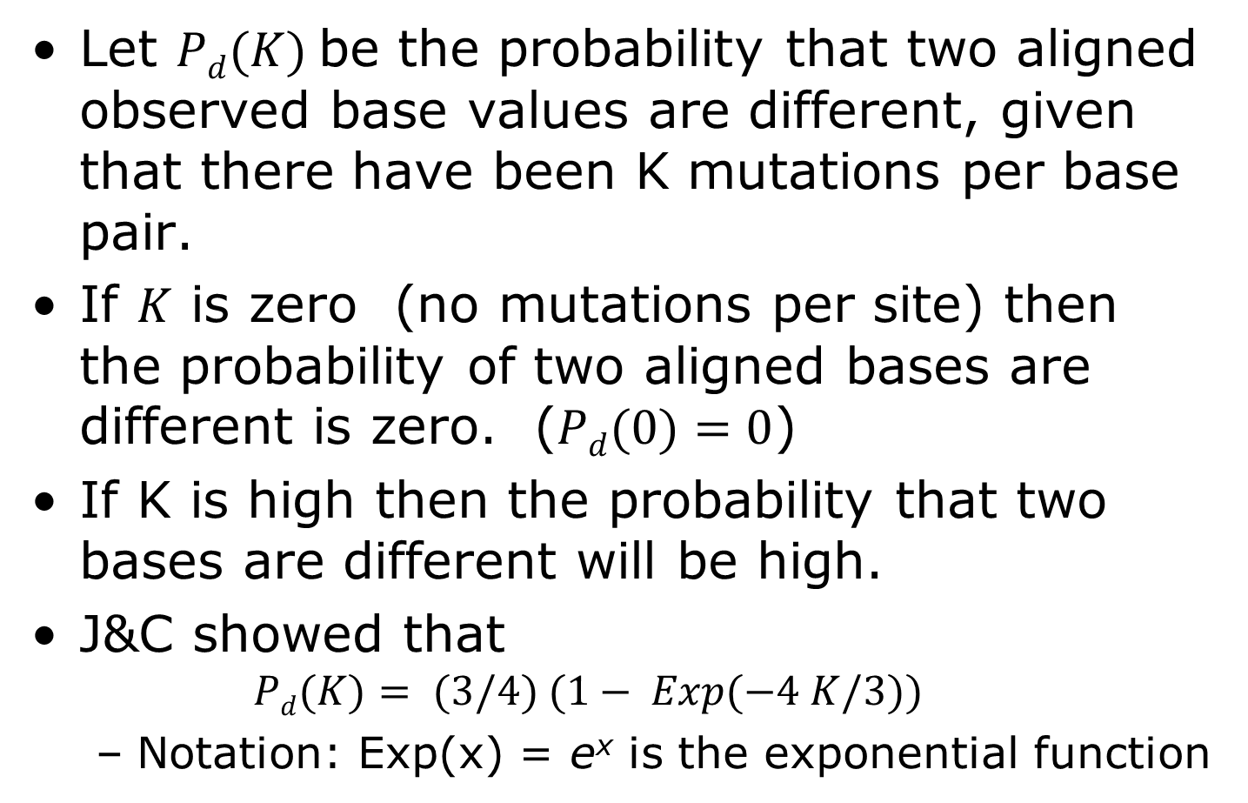

Estimating $K$ using Jukes & Cantor
Let $Pd(K)$be the probability that two aligned observed base values are different, given that there have been K mutations per base pair.
If $K$ is zero (no mutations per site) then the probability of two aligned bases are different is zero. ($Pd(0)=0$)
If K is high then the probability that two bases are different will be high.
J&C showed that
$$Pd(K)= (3/4) (1− Exp(−4 K/3))$$
Notation: Exp(x) = e^{x} is the exponential function

Slide 10
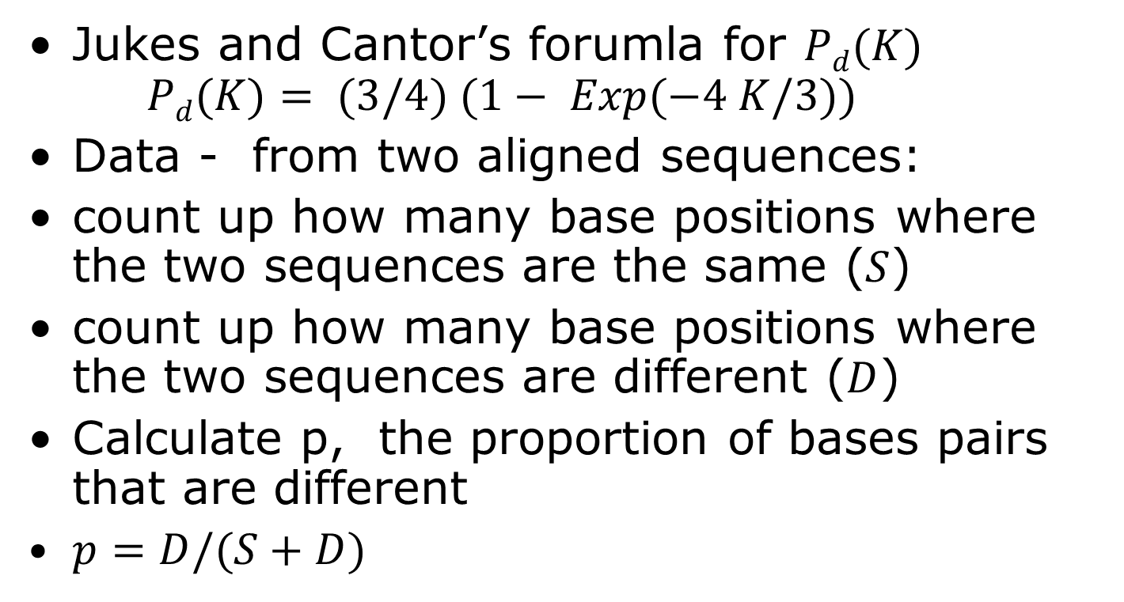
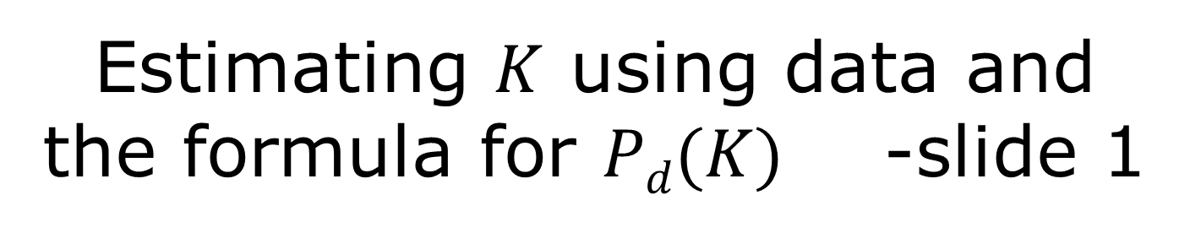
Estimating $K$ using data and the formula for $Pd(K)$ -slide 1
Jukes and Cantor’s forumla for $Pd(K)$ $Pd(K)= (3/4) (1− Exp(−4 K/3))$
Data - from two aligned sequences:
count up how many base positions where the two sequences are the same ($S$)
count up how many base positions where the two sequences are different ($D$)
Calculate p, the proportion of bases pairs that are different
$p=D/(S+D)$

Slide 11
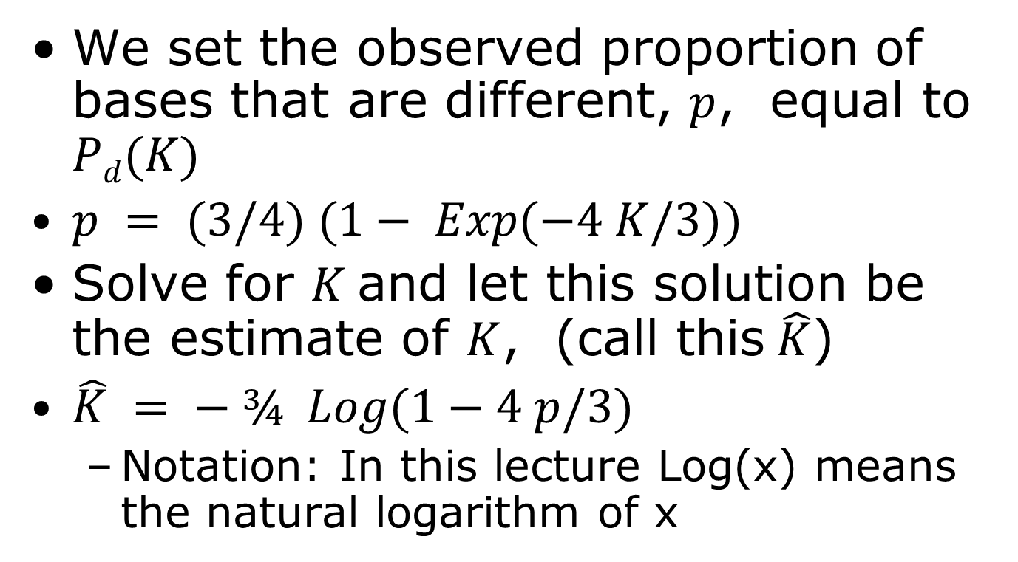
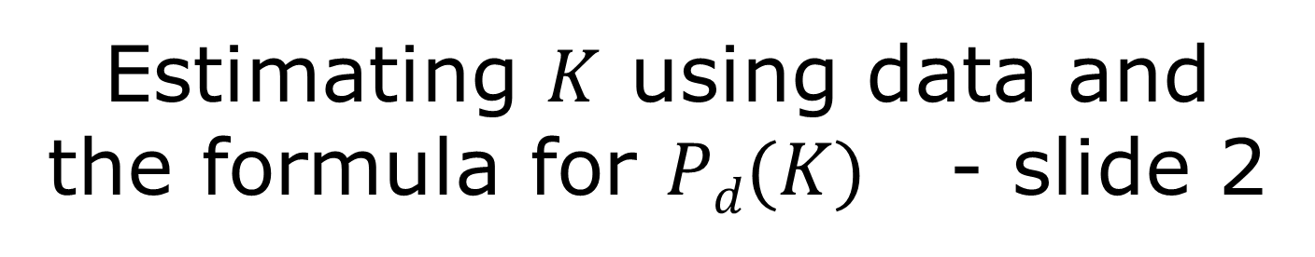
Estimating $K$ using data and the formula for $Pd(K)$ - slide 2
We set the observed proportion of bases that are different, $p$, equal to $Pd(K)$
$p = (3/4) (1− Exp(−4 K/3))$
Solve for $K$and let this solution be the estimate of $K$, (call this$\hat{K}$)
$\hat{K} = − ¾ Log(1−4 p/3)$
Notation: In this lecture Log(x) means the natural logarithm of x

Slide 12
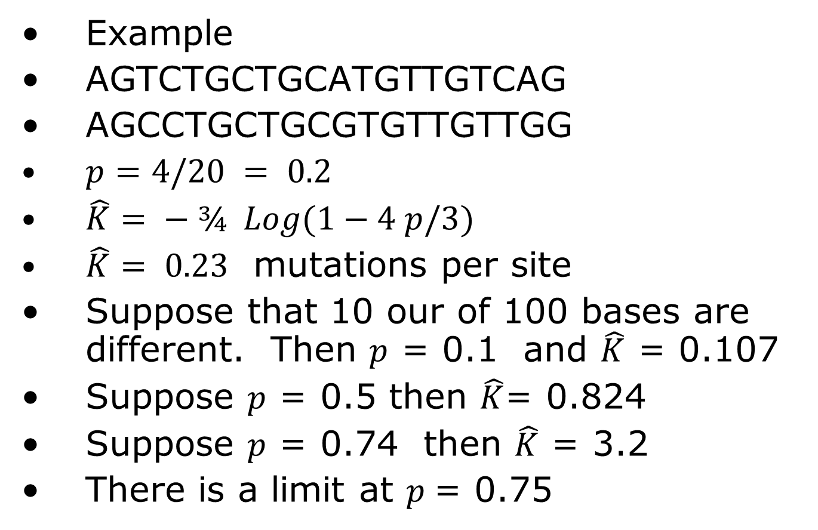

Estimating $K$ example
Example
AGTCTGCTGCATGTTGTCAG
AGCCTGCTGCGTGTTGTTGG
$p=4/20 = 0.2$
$\hat{K}= − ¾ Log(1−4 p/3)$
$\hat{K}= 0.23$ mutations per site
Suppose that 10 our of 100 bases are different. Then $p$ = 0.1 and $\hat{K}$ = 0.107
Suppose $p$ = 0.5 then $\hat{K}$= 0.824
Suppose $p$ = 0.74 then $\hat{K}$ = 3.2
There is a limit at $p$= 0.75

Slide 13
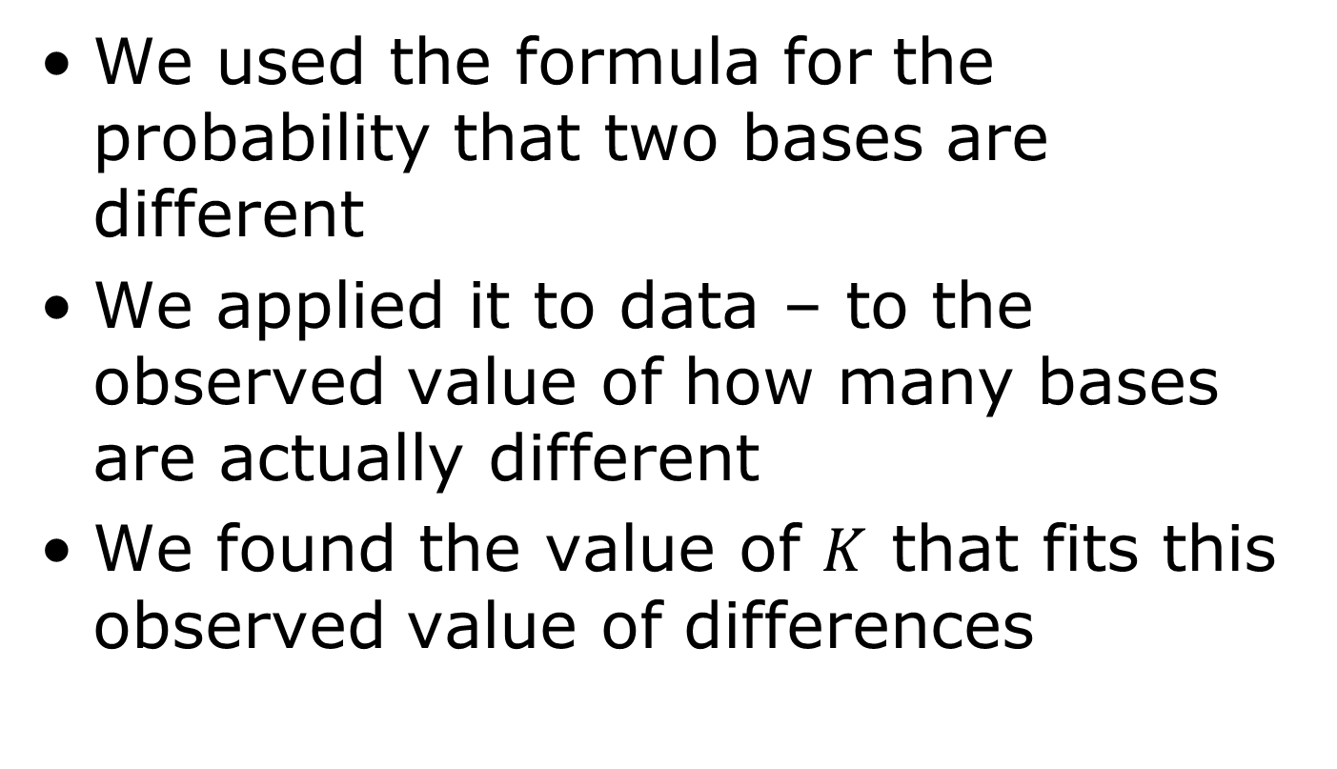
What have we done?
We used the formula for the probability that two bases are different
We applied it to data – to the observed value of how many bases are actually different
We found the value of $K$ that fits this observed value of differences

Slide 14
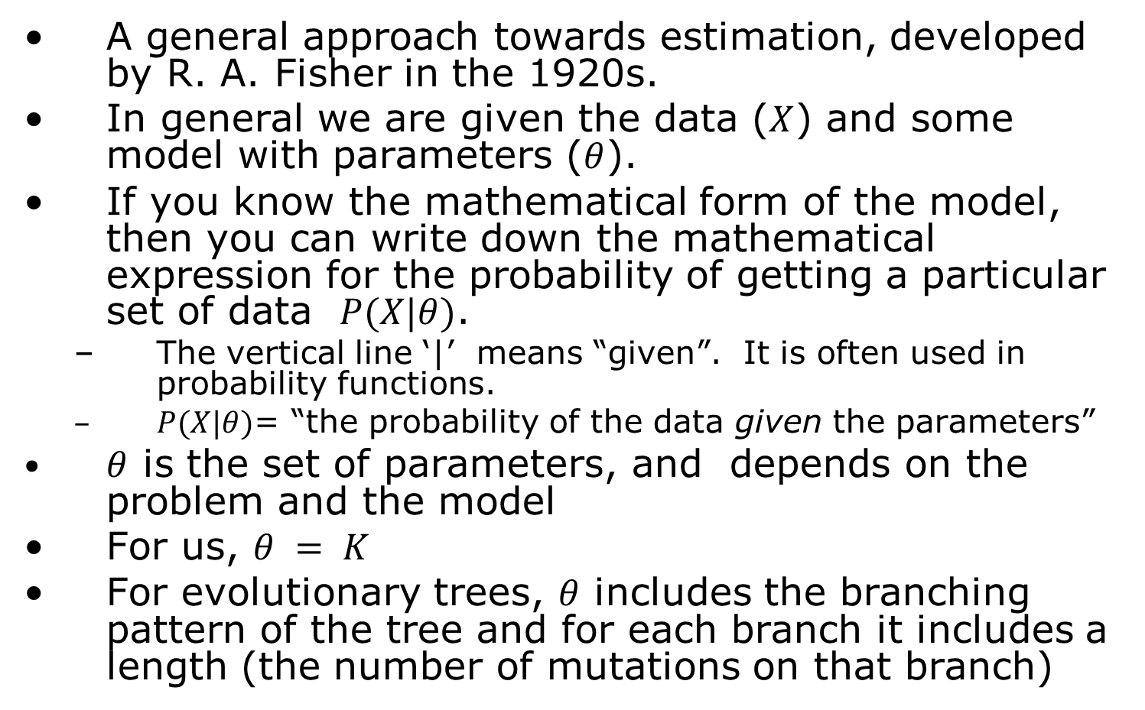
Maximum Likelihood
A general approach towards estimation, developed by R. A. Fisher in the 1920s.
In general we are given the data ($X$) and some model with parameters ($θ$).
If you know the mathematical form of the model, then you can write down the mathematical expression for the probability of getting a particular set of data $P(X|θ)$.
The vertical line ‘|’ means “given”. It is often used in probability functions.
$P(X|θ)$= “the probability of the data given the parameters”
$θ$ is the set of parameters, and depends on the problem and the model
For us, $θ = K$
For evolutionary trees, $θ$ includes the branching pattern of the tree and for each branch it includes a length (the number of mutations on that branch)

Slide 15
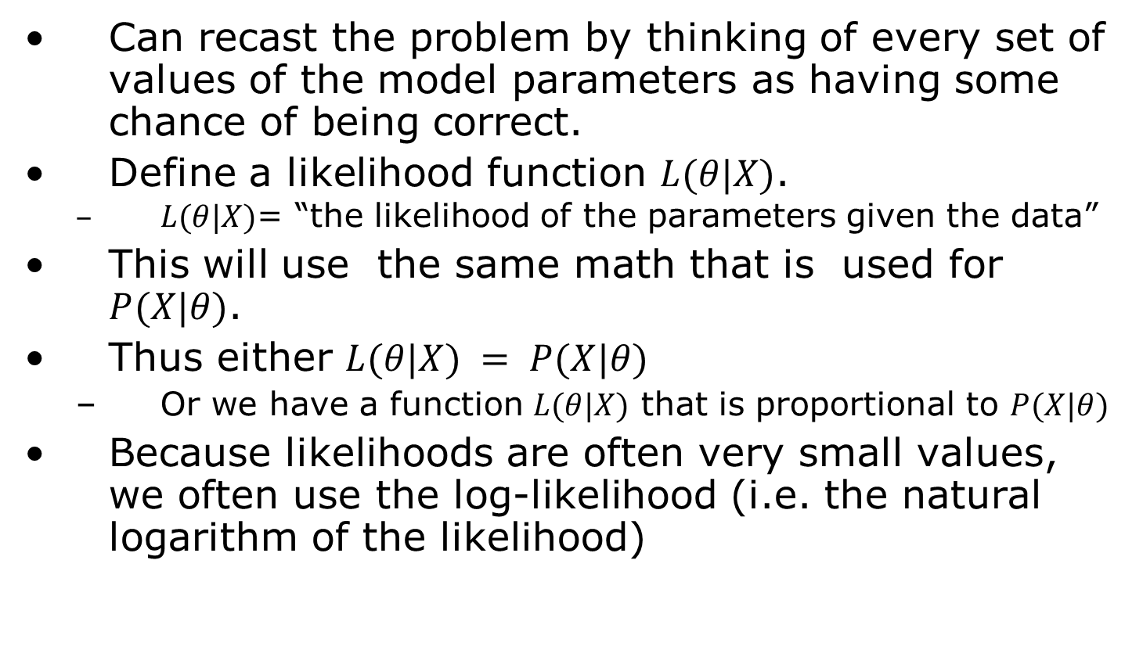
Maximum Likelihood-2
Can recast the problem by thinking of every set of values of the model parameters as having some chance of being correct.
Define a likelihood function $L(θ|X)$.
$L(θ|X)$= “the likelihood of the parameters given the data”
This will use the same math that is used for $P(X|θ)$.
Thus either $L(θ|X) = P(X|θ)$
Or we have a function $L(θ|X)$ that is proportional to $P(X|θ)$
Because likelihoods are often very small values, we often use the log-likelihood (i.e. the natural logarithm of the likelihood)

Slide 16
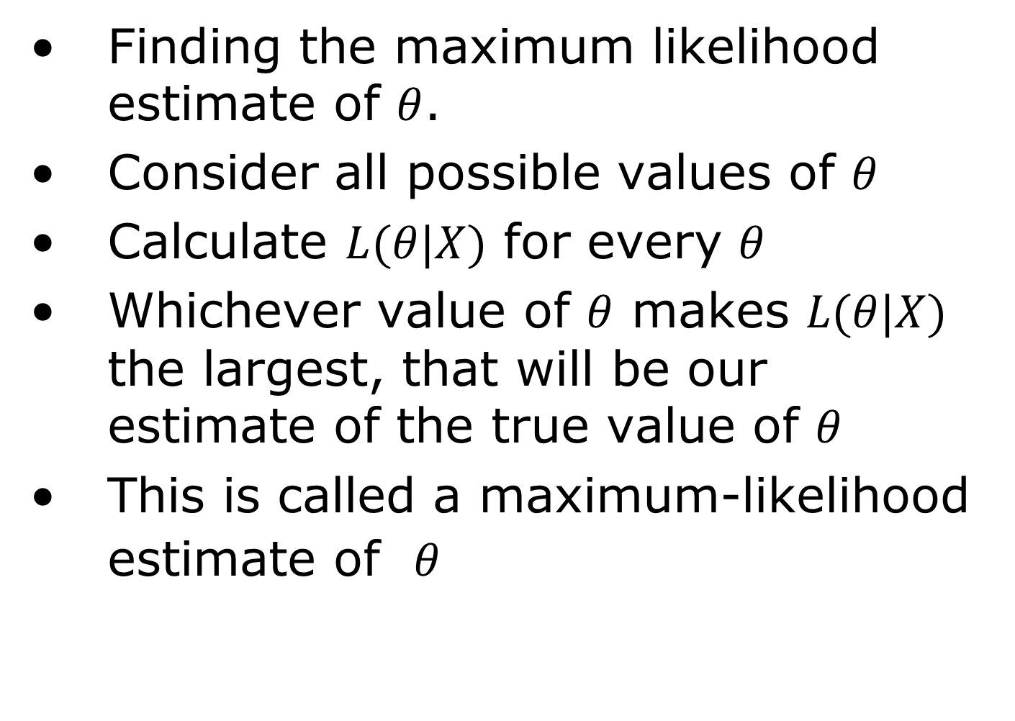
Maximum Likelihood-3
Finding the maximum likelihood estimate of $θ$.
Consider all possible values of $θ$
Calculate $L(θ|X)$ for every $θ$
Whichever value of $θ$ makes $L(θ|X)$ the largest, that will be our estimate of the true value of $θ$
This is called a maximum-likelihood estimate of $θ$

Slide 17
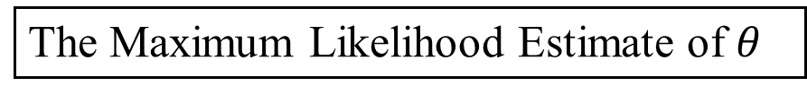


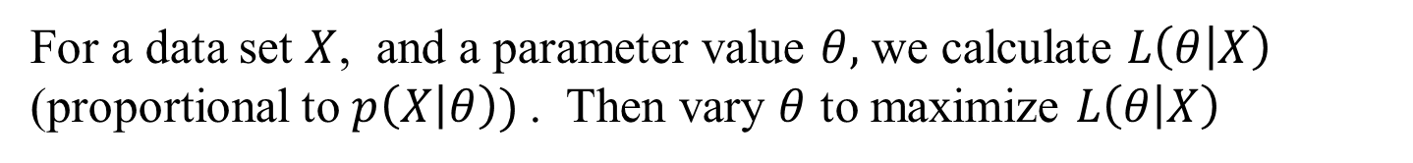
Maximum Likelihood diagram
For a data set $X$, and a parameter value $θ,$ we calculate $L\left(θ | X\right)$ (proportional to $p\left(X | θ\right))$. Then vary $θ$ to maximize $L\left(θ | X\right)$
The Maximum Likelihood
$$L\left(θ | X\right)$$
$θ$
The Maximum Likelihood Estimate of $θ$

Slide 18
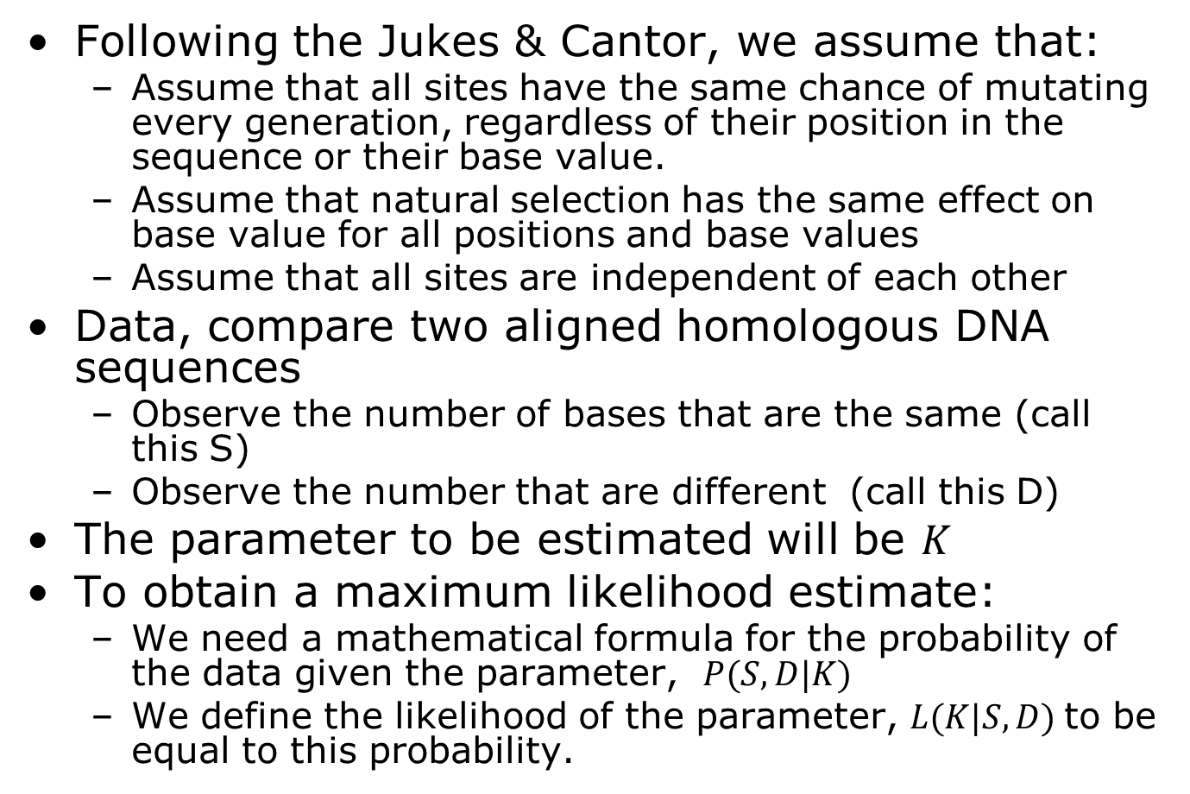
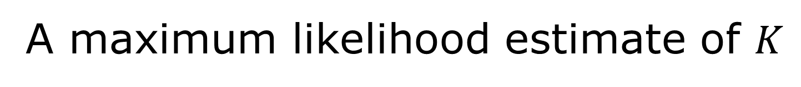
A maximum likelihood estimate of $K$
Following the Jukes & Cantor, we assume that:
Assume that all sites have the same chance of mutating every generation, regardless of their position in the sequence or their base value.
Assume that natural selection has the same effect on base value for all positions and base values
Assume that all sites are independent of each other
Data, compare two aligned homologous DNA sequences
Observe the number of bases that are the same (call this S)
Observe the number that are different (call this D)
The parameter to be estimated will be $K$
To obtain a maximum likelihood estimate:
We need a mathematical formula for the probability of the data given the parameter, $P(S, D|K)$
We define the likelihood of the parameter, $L(K|S,D)$to be equal to this probability.

Slide 19
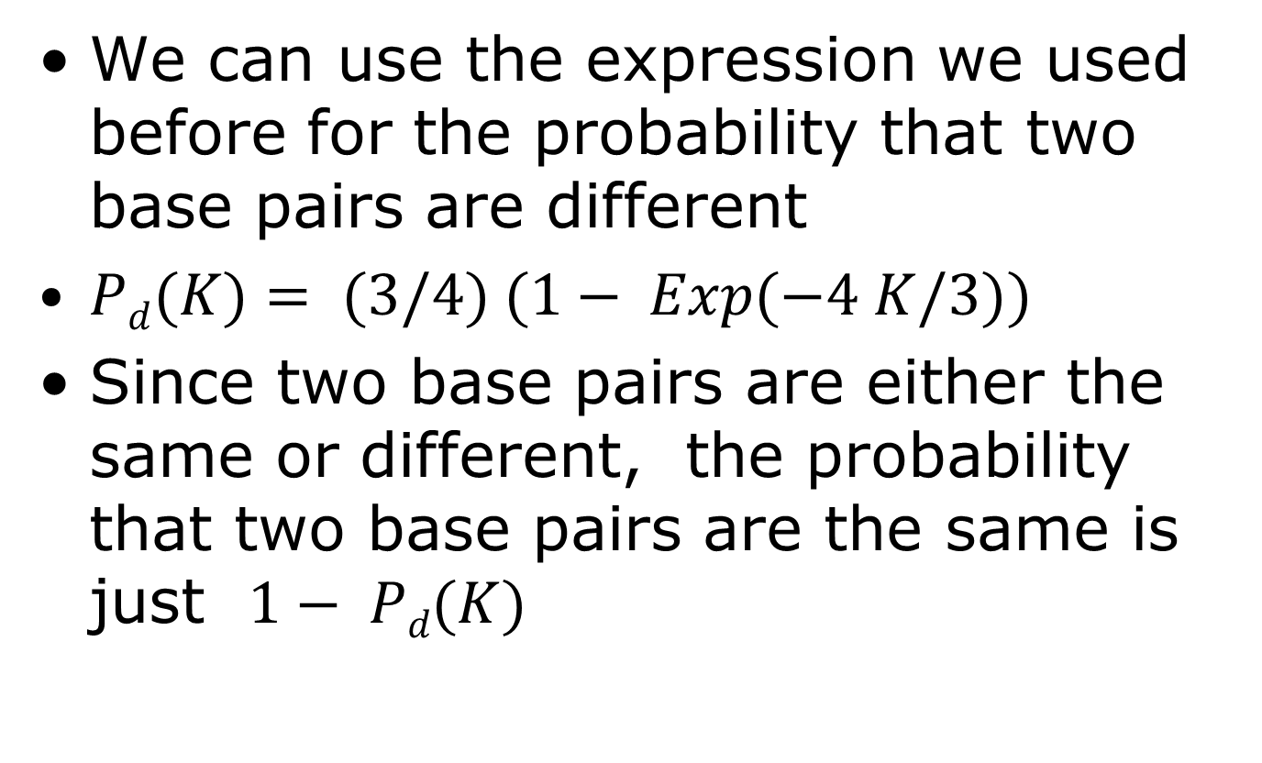
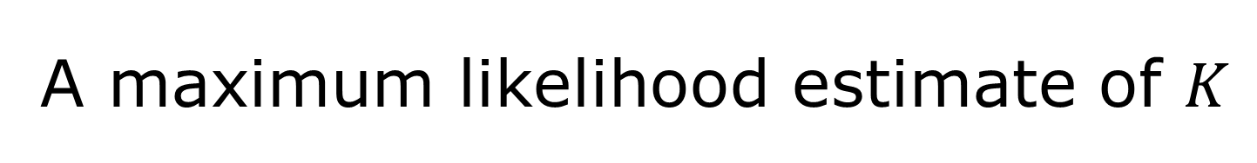
A maximum likelihood estimate of $K$
We can use the expression we used before for the probability that two base pairs are different
$Pd(K)= (3/4) (1− Exp(−4 K/3))$
Since two base pairs are either the same or different, the probability that two base pairs are the same is just $1− Pd(K)$

Slide 20
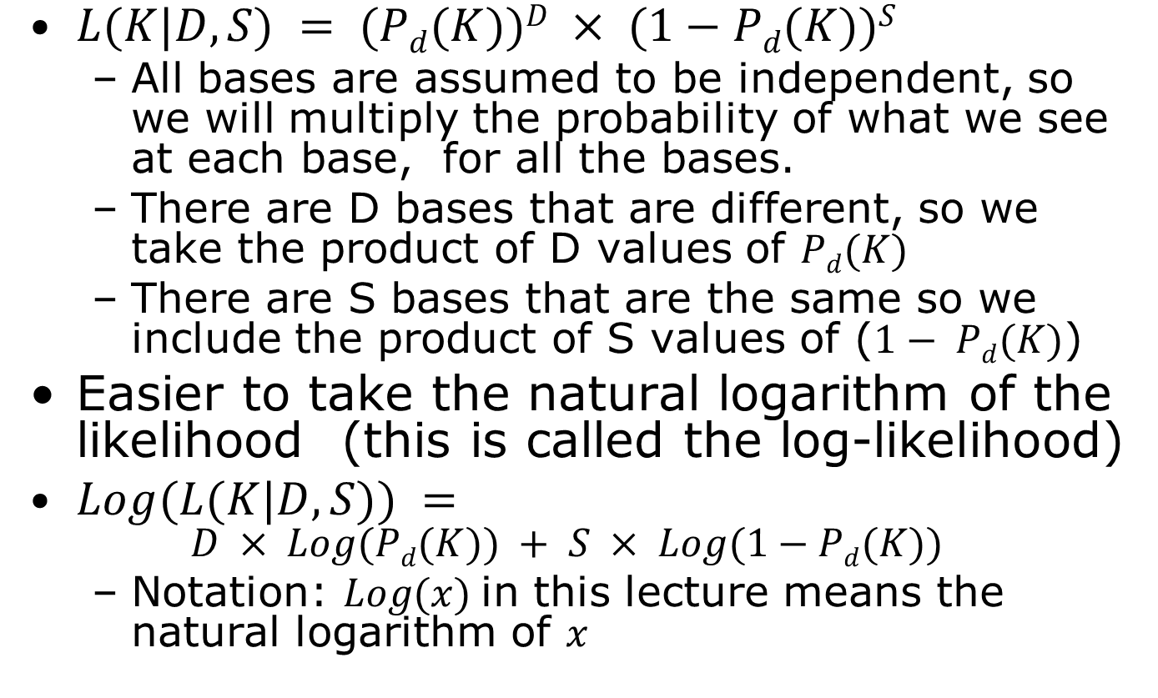
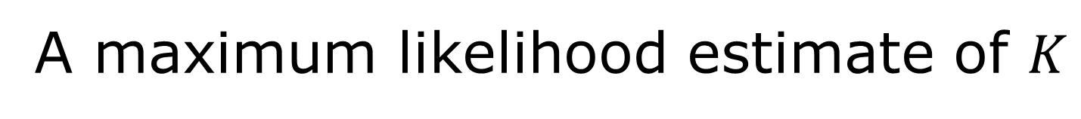
A maximum likelihood estimate of $K$
$L(K|D,S) = (Pd(K))D × (1−Pd(K))S$
All bases are assumed to be independent, so we will multiply the probability of what we see at each base, for all the bases.
There are D bases that are different, so we take the product of D values of $Pd(K)$
There are S bases that are the same so we include the product of S values of ($1− Pd(K)$)
Easier to take the natural logarithm of the likelihood (this is called the log-likelihood)
$Log(L(K|D,S)) =$
$$D × Log(Pd(K)) + S × Log(1−Pd(K))$$
Notation: $Log(x)$in this lecture means the natural logarithm of $x$

Slide 21
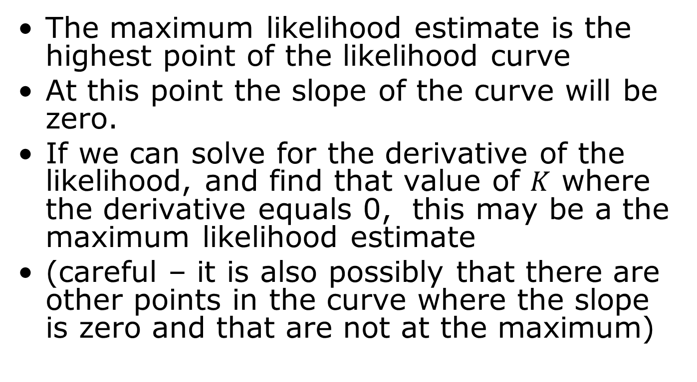
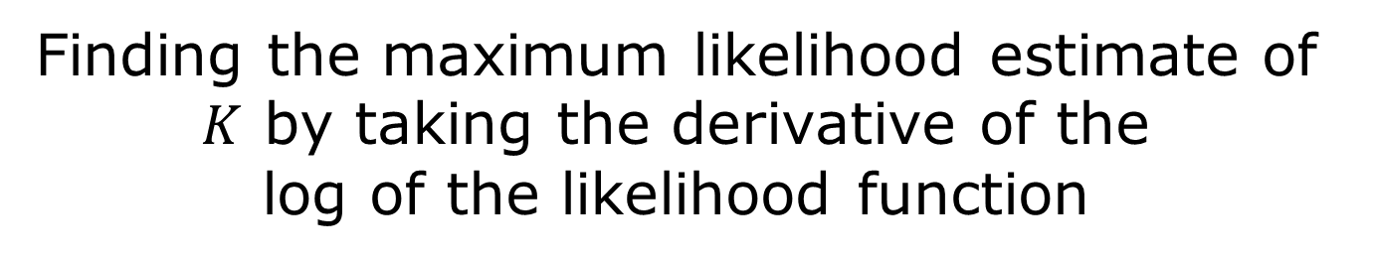
Finding the maximum likelihood estimate of $K$ by taking the derivative of the log of the likelihood function
The maximum likelihood estimate is the highest point of the likelihood curve
At this point the slope of the curve will be zero.
If we can solve for the derivative of the likelihood, and find that value of $K$ where the derivative equals 0, this may be a the maximum likelihood estimate
(careful – it is also possibly that there are other points in the curve where the slope is zero and that are not at the maximum)

Slide 22
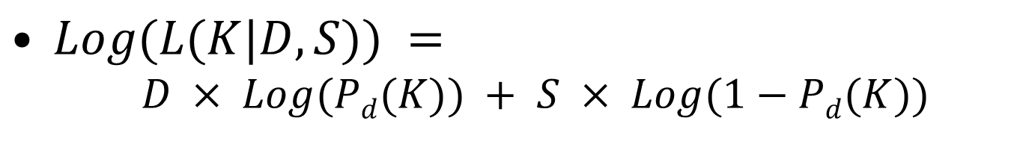
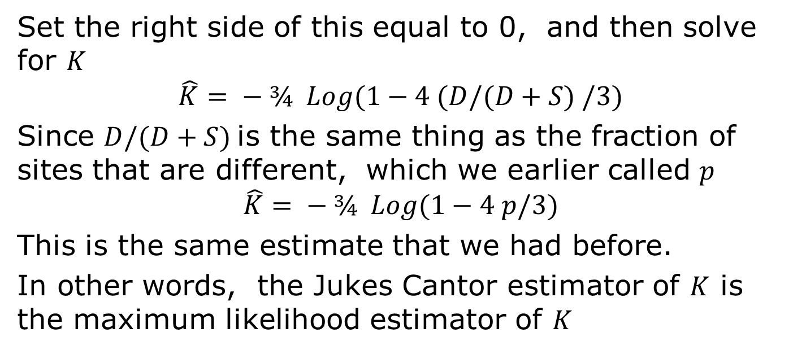
Calculating the ML estimate
$Log(L(K|D,S)) =$
$$D × Log(Pd(K)) + S × Log(1−Pd(K))$$
Set the right side of this equal to 0, and then solve for $K$
$$\hat{K}= − ¾ Log(1−4 (D/(D+S) /3)$$
Since $D/(D+S)$is the same thing as the fraction of sites that are different, which we earlier called $p$
$$\hat{K}= − ¾ Log(1−4 p/3)$$
This is the same estimate that we had before.
In other words, the Jukes Cantor estimator of $K$ is the maximum likelihood estimator of $K$

